Slide 1

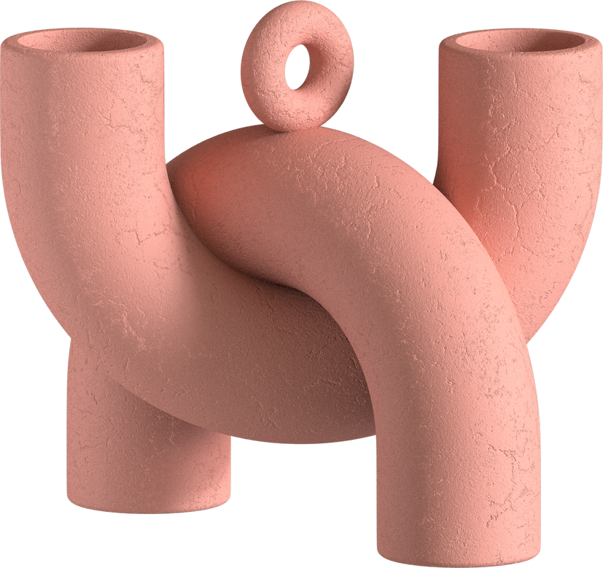
AI-Based Intelligent Chatbot
By
Datha Sai
14th February

Slide 2
01
Introduction
02
Chatbot Features
03
Technology Overview
Chatbot
04
System Architecture
05
Chatbot Training
What to Know
06
Demonstration
07
Conclusion & Future Work

Slide 3

Objective: To automate the resolution of common admissions queries, freeing up human resources for more complex tasks and improving prospective students' engagement.
Introduction
Identified a high volume of repetitive and routine queries to admission offices, leading to inefficiencies and delays.
Developed an AI-based chatbot to provide instant, accurate, and personalized responses to admission inquiries, enhancing user experience and operational efficiency.

Slide 4

01
Automated responses to FAQs on admissions procedures, deadlines, and requirements.
02
Personalized interaction by understanding user-specific queries and providing relevant information.
Features
03
Capability to guide users to appropriate resources, improving navigation and information discovery on the institute's website.

Slide 5

Technology Overview
Employed NLP techniques through the SBERT model for semantic understanding of user queries.
Utilized Python for backend development and Streamlit for creating an intuitive user interface.
Compiled a comprehensive dataset from the institute's admissions content to train the chatbot, ensuring a wide range of query handling.

Slide 6


User Interface crafted with Streamlit, ensuring a friendly and accessible user experience.
System Architecture
The NLP engine, powered by SBERT, processes user inputs to understand context and intent, fetching the most relevant answers from the knowledge base.

Slide 7
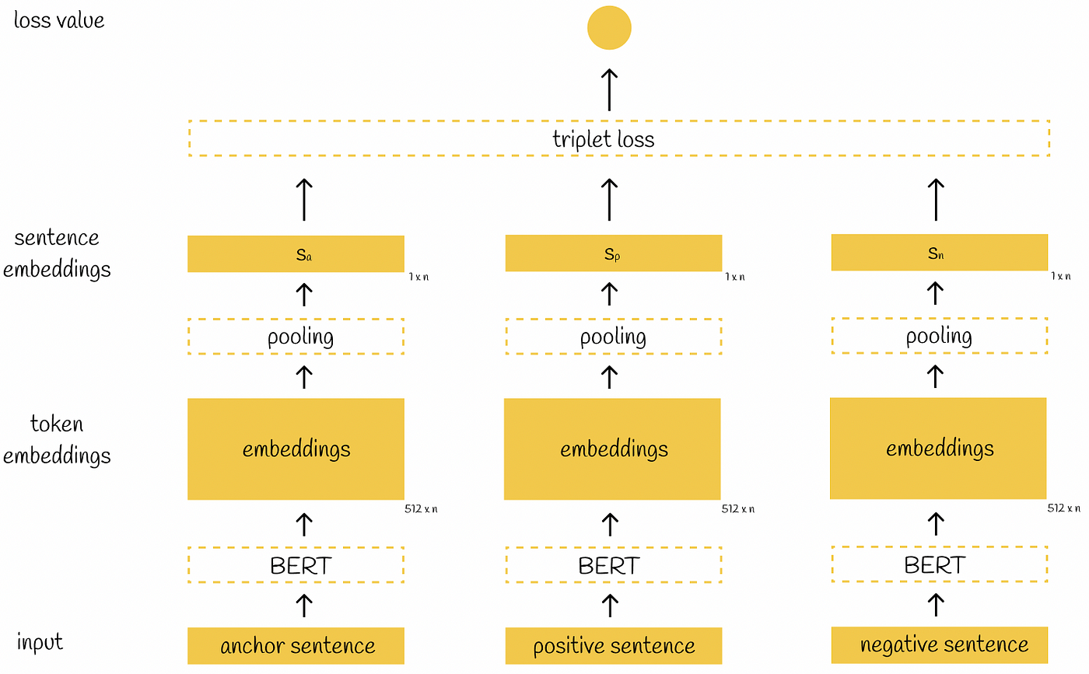
System Architecture
Input: Anchor, Positive, and Negative sentences.
BERT: Processes sentences, outputs token embeddings.
Pooling: Aggregates token embeddings into fixed-size sentence embeddings.
Triplet Loss: Guides training to minimize distance between Anchor-Positive pairs and maximize distance between Anchor-Negative pairs.
Outcome: Loss value, minimized during training to improve sentence embeddings.

Slide 8
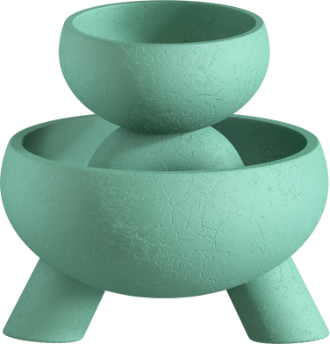
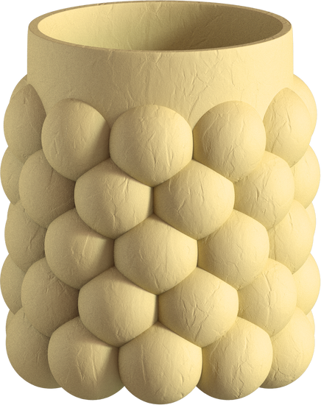
Curated a dataset from the institute's admissions web pages, converting content into structured question-answer pairs for training.
Chatbot Training
Chose SBERT for its effectiveness in generating meaningful sentence embeddings, facilitating accurate matching of user queries with stored answers.
Measured performance through metrics like accuracy in response relevance and user satisfaction, ensuring the chatbot meets expected standards.

Slide 9
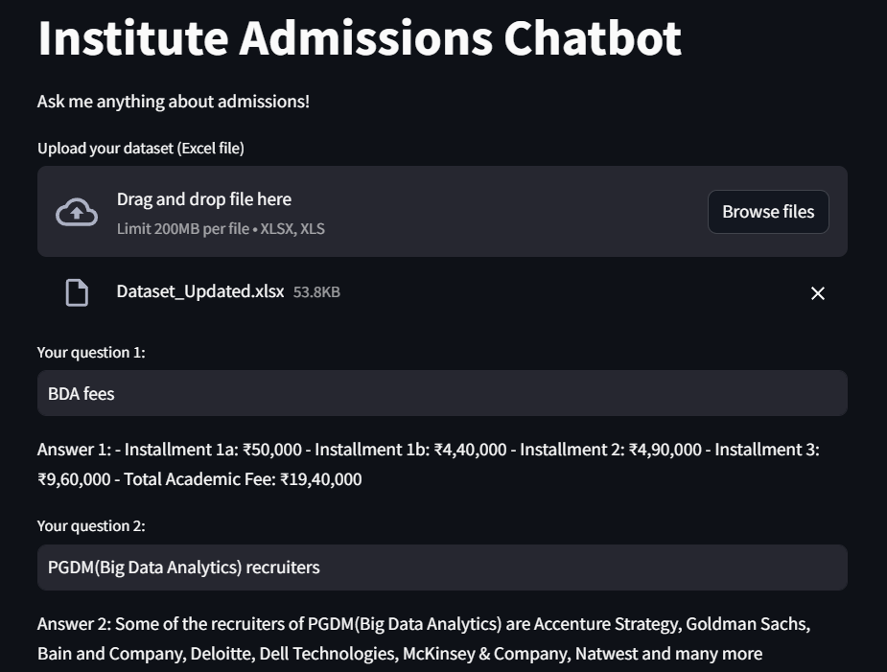
Demonstration
Functionality: Automated responses to admissions queries, enhancing user experience.
Dataset Upload: Enables administrators to update the chatbot's knowledge base.
User Experience Design: Clean layout, aligned with institute's branding.
Technological Implementation: Utilizes SBERT for semantic understanding and Python for backend.
Summary: Functional interface demonstrating instant, accurate responses to admission queries, aligning with project objectives.

Slide 10


Successfully achieved project objectives, creating a scalable, efficient, and user-friendly chatbot for admissions queries.
Conclusion & Future Work
Identified opportunities for further development, such as expanding the knowledge base and integrating more advanced NLP features for deeper conversation context understanding.

Slide 11

Thank You

